Slide 1
GREAT DATA. GREAT INSIGHTS.
HELPING FAMILY OFFICES ACHIEVE DATA INDEPENDENCE

Slide 2
ABOUT US
Wealth Management’s Most Trusted Private Wealth Aggregation Utility
Experienced
Founded by 40 UHNW families and now serving nearly $500b in assets, the needs of the family office and their service providers are in our DNA.
Trusted
Our clients include the most prestigious families, advisors, private banks, trusts, consultants and technology firms.
Innovative
We have applied our 20 years of experience to a complete rethink of complex multi-asset class aggregation.
Strategic
We are a strategic partner helping guide how firms leverage data to benefit from the best wealth management technology has to offer.

Slide 3
FAMILY OFFICE SOLUTIONS

Slide 4
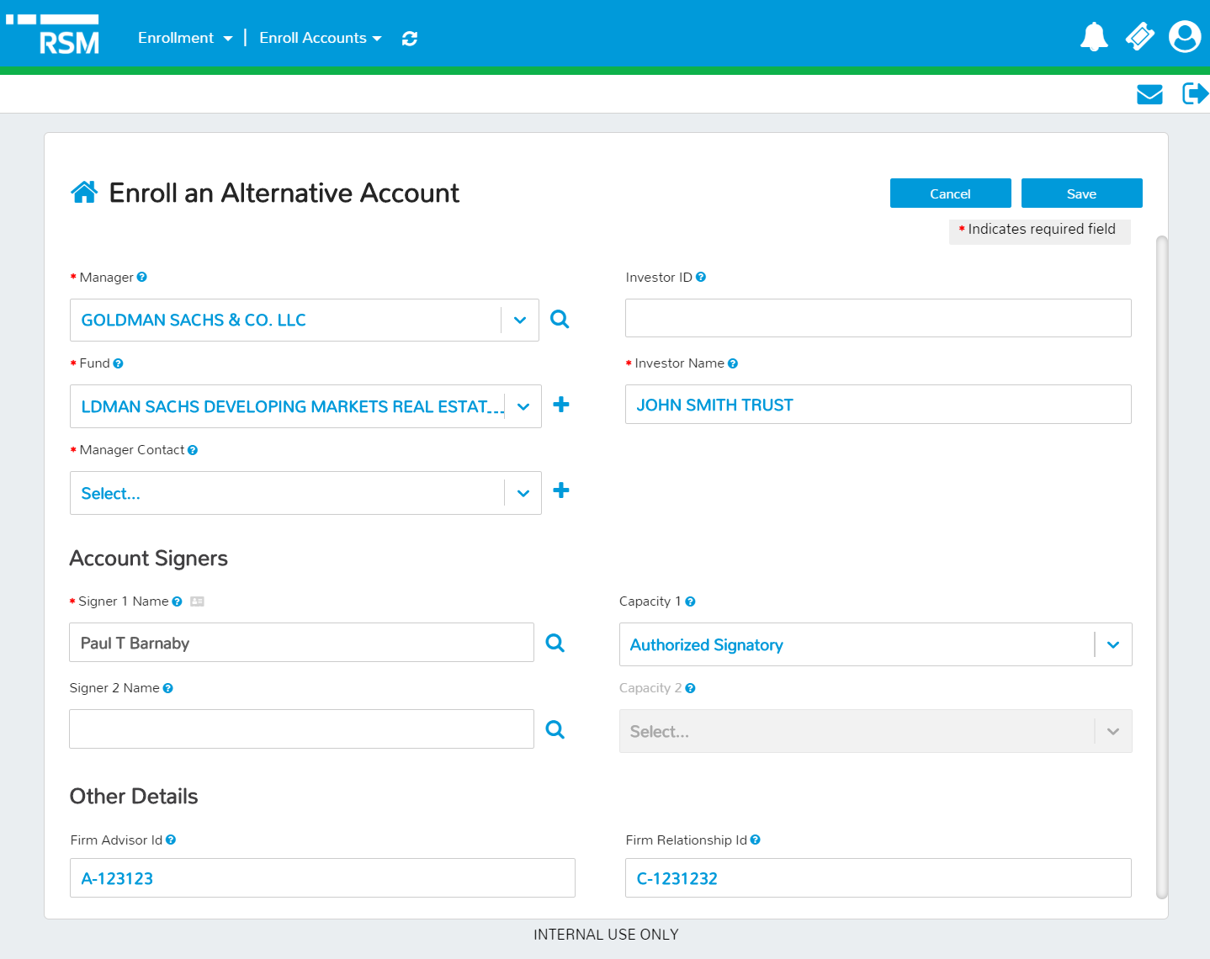
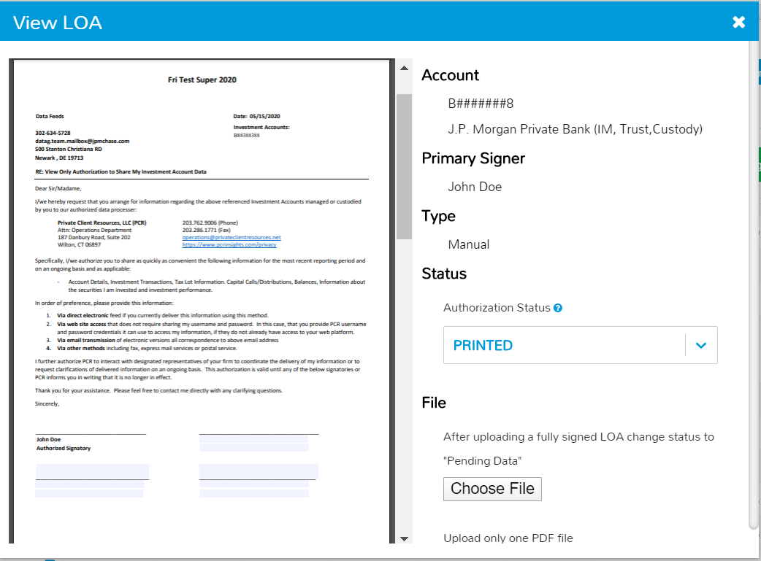
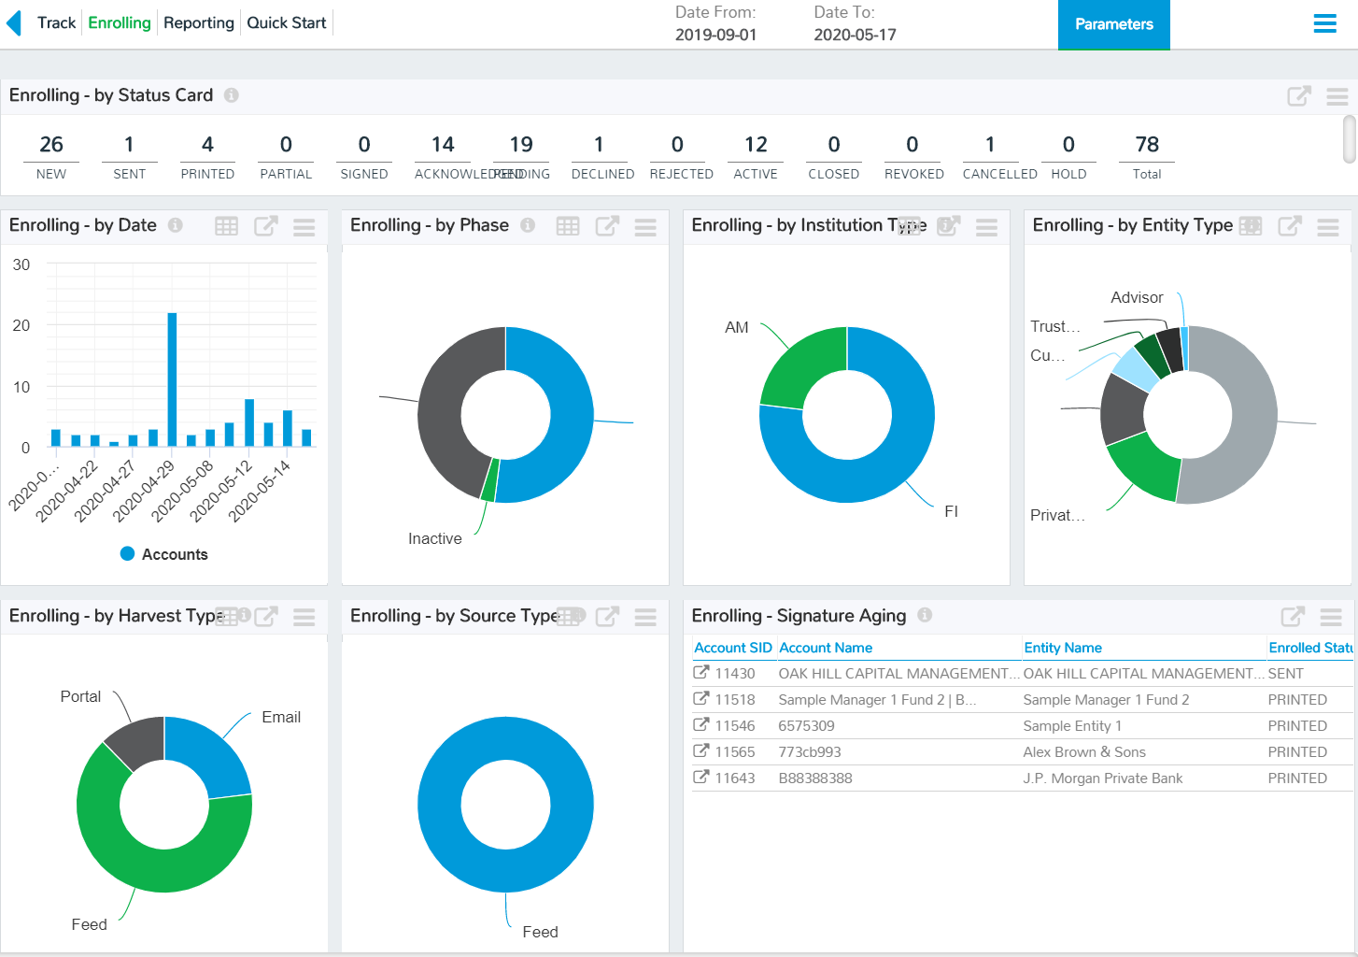
#1 STREAMLINED ACCOUNT ENROLLMENT
95% of PCR Accounts Are Enrolled Using our Digital Consent Technology
We used the experience of 20 years serving private clients and managing 100’s of thousands of alternative accounts to develop the industries first digital consent platform for Letters of Authorization based aggregation.
EASY-TO-USE
SAFE AND SECURE
TRANSPARENT
FIRM
Your advisors or ops teams easily select from over 40,000 tracked vehicles or identify new ones and complete this simple form to automate the generation of Letters of Authorization.
Once entered, the app creates a “Smart-LOA” which contains any manager/institution content or addendums. The document is sent to signers and then manager using Docu-sign.
The application provides complete transparency including tracking completed LOA’s and statistics on both enrolling and reporting accounts.

Slide 5
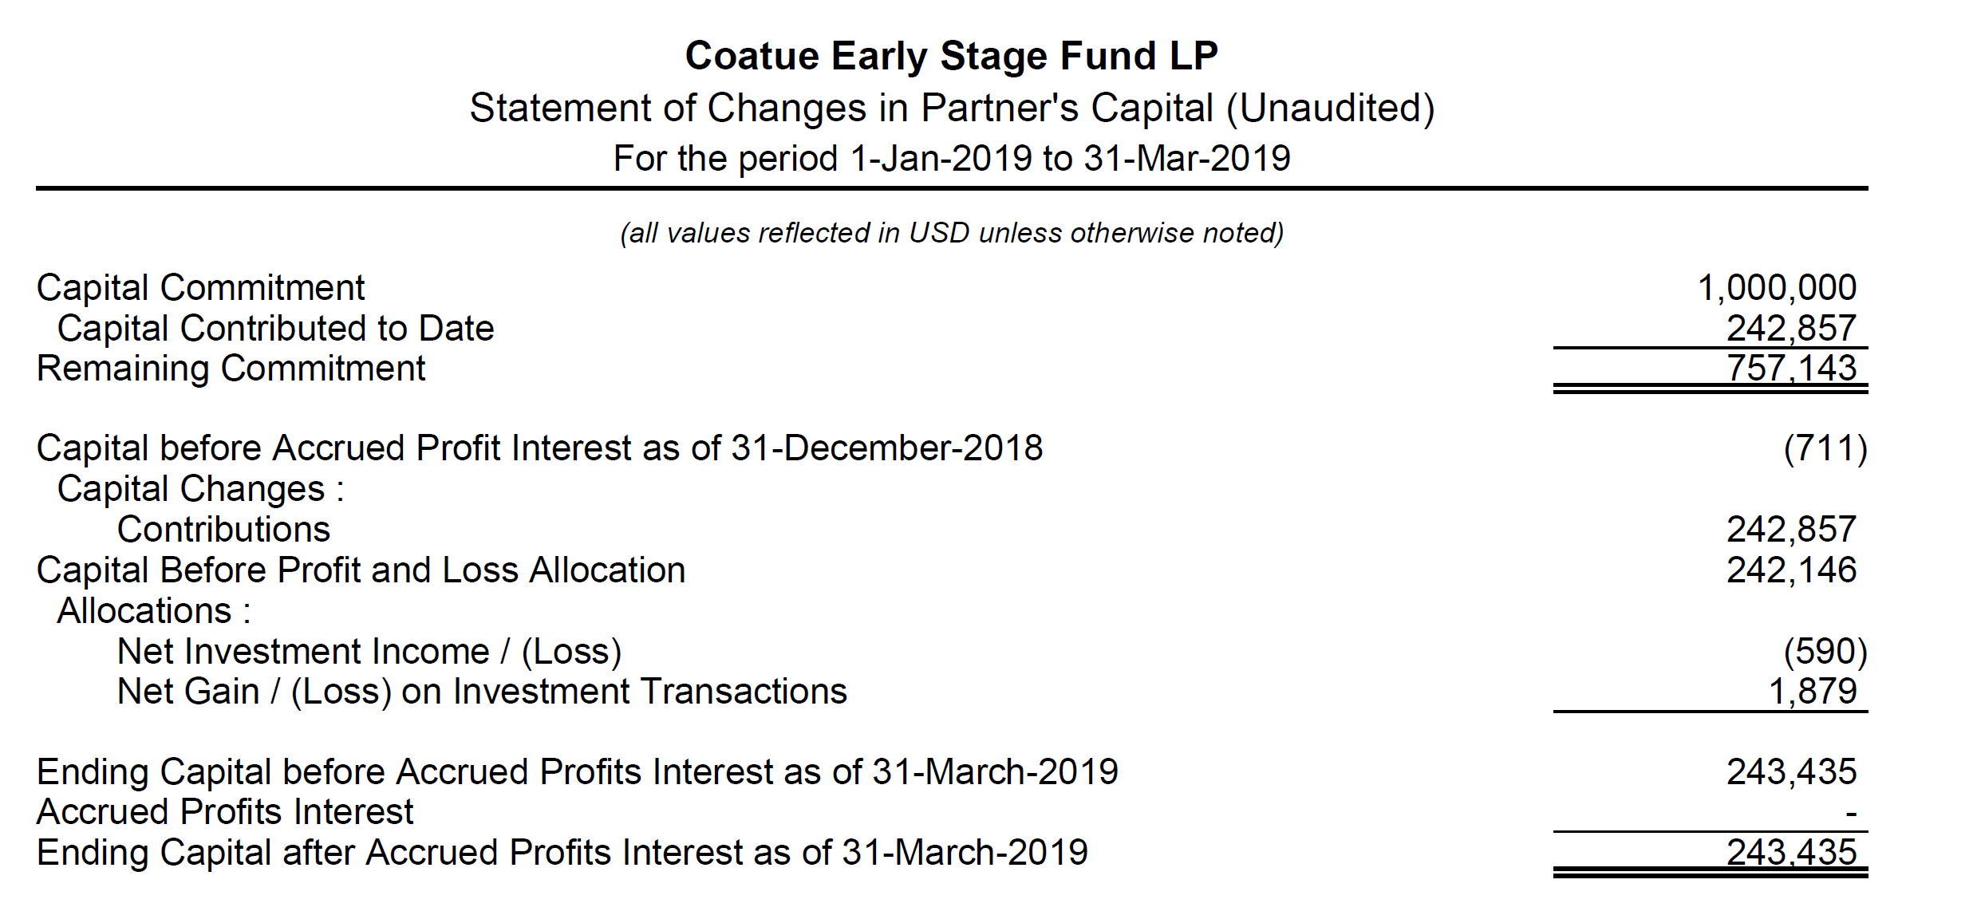
#2 STATEMENT AUTOMATION
$500B Assets Aggregated on PCR Platform
60% of Assets Reported on Statements
85% of Statements are Automated
REPORTING EVENTS
RECONCILED TRANSACTIONS
Valuations Statements Capital Calls
Distribution Notices K-1’s
Specialized automation and financial analyst teams ensure complete processing, accuracy and continuous improvement across millions of reporting events.
HARVEST RPA enabled gathering of non-structured content from 1,000’s of email Inboxes, web portals and ftp locations.
IDENTIFY Securely identifies vehicle and associates with authorized investment accounts
TRANSFORM Extracts data and converts to structured standard investment transactions
VALIDATE Perform dozens of quality checks to ensure data is complete – raise issues to financial analysts.
EXTRACT Validated presented to aggregation and recon as fully normalized transaction activity
RECON Once transformed, reported activity is subjected to same rigorous recon as all investment data.
PUBLISH Both the transactions and positions, together with source documents are delivered to your systems

Slide 6
#3 QUALITY DATA
PCR is More Than Just an Aggregator. We Curate Data and Make it Analysis Ready.
SOURCES
ASSET CLASSES
DATA QUALITY
ANALYSIS READY
Investment Data
Custodial Feeds
Statements
Cap Calls
K1’s
Estimates
Firm Feeds
Appraisals
Client Sourced
Marketable
Equities
Bonds/Fixed Income
Currency Trading
Reconcile
Positions
Tax Lots
Cash Flows
Multi-point
Custom Recon
Normalization
Transaction Codes
Asset Classifications
Corporate Actions
Geography
Client Preference
Multi-Currency
Alternatives
Hedge Funds
Fund of Funds
Private Equity
Real Estate
PCR uses an Accounting-Based approach to aggregation which causes all activity to translate into transactions, coded with standard transaction codes regardless of source and associated with a robust, market-data-fed security master.
The result is data of a quality and consistency that can be used directly in other reporting and analytic systems.
Quality
Variance Checks
Range Checks
60 Other Controls
Pricing
Market
Waterfall
Average
Custom
Pass-through
Other Illiquid
Insurance Assets
Business Interests
Personal Assets

Slide 7
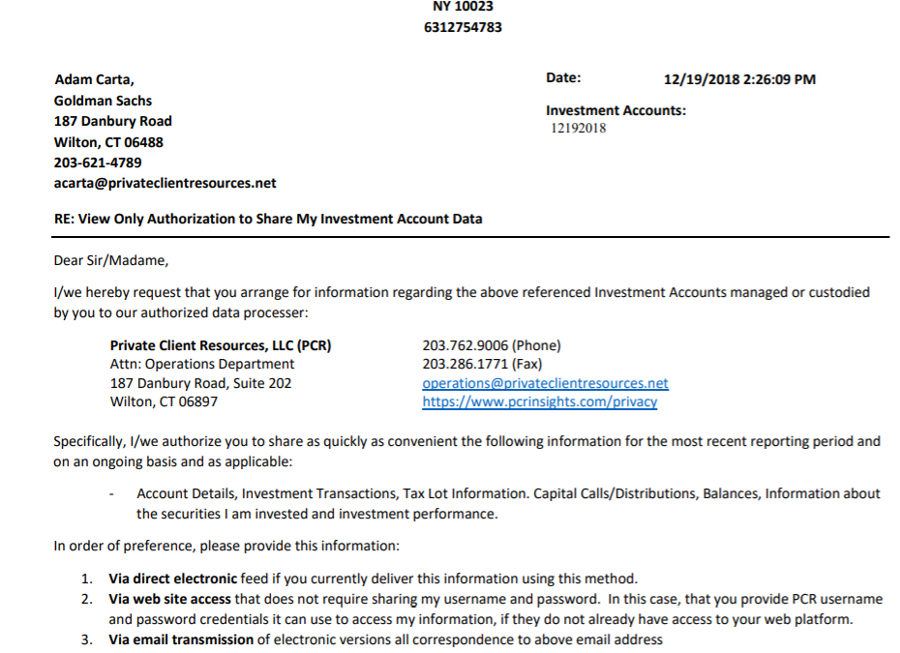
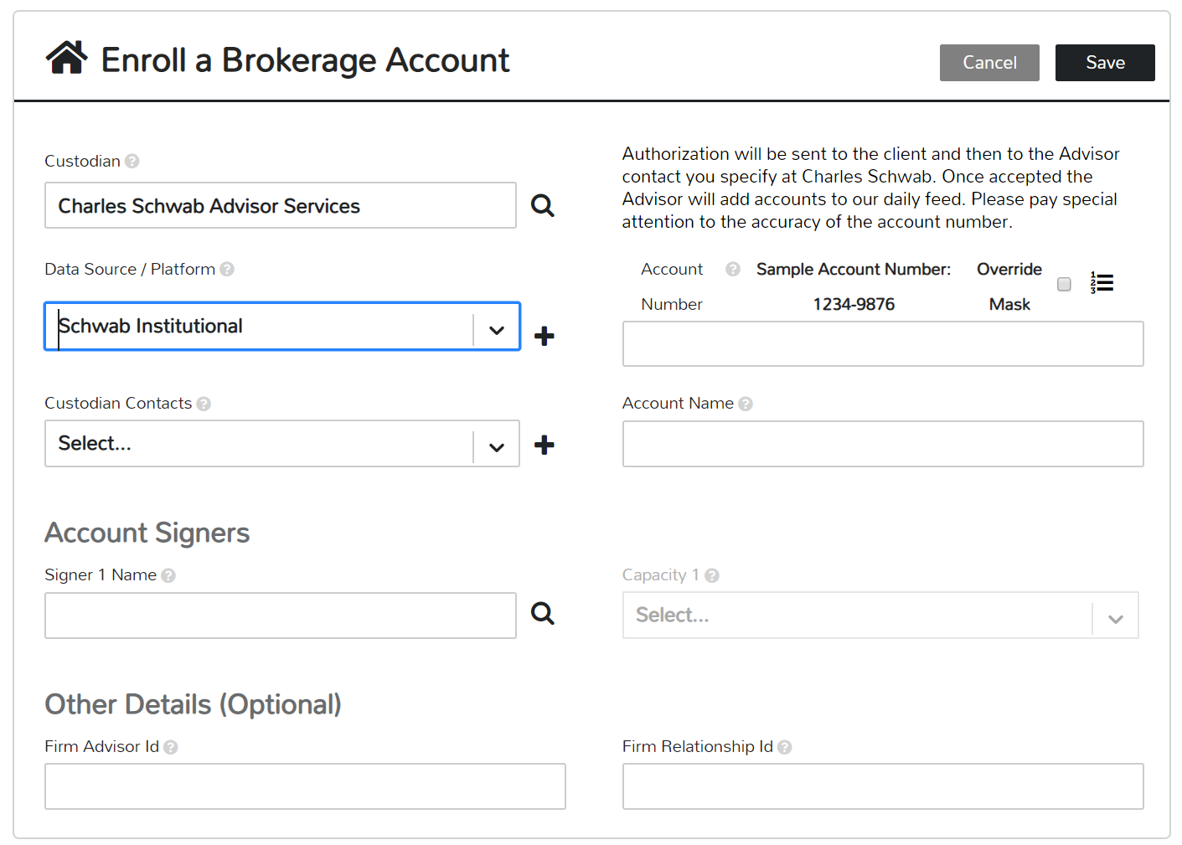
#4 PRIVACY FIRST ARCHITECTURE
It Is a Dangerous World So We Started With a Privacy First Architecture
Consent Technology
Privacy Technology
Personal data, account numbers and investment data are stored in separate data centers. This groundbreaking approach requires that three data centers be breached simultaneously to associate your information.
Combined with best-in-class hosting, encryption and security practices, PCR is a platform of choice for many leading institutions and families.
Regulatory Technology
Whether as required by GDPR or emerging privacy regulations in the US (California) we built data subject rights management into the platform from the start.
Workflows support information requests, delete me, give me a copy of my data etc. Personal information may also be hosted within multiple regulatory jurisdictions (e.g. Switzerland, Canada)
Safely and efficiently enroll investment accounts, produce digital LOA and support eSignature workflows.
No screen scraping or credential sharing. No printing, scanning, signing and emailing sensitive information.
Account Numbers
Digital Consent
Custodian
Manager
Advisor
Investment Data
Your Firm
Systems
TOKENIZE
DETOKENIZE
Personal
Data

Slide 8
#5 SEAMLESS INTEGRATION
500+ Institutional Sources
US and Europe
Custodians, Banks, Trust Companies
Efficient Feed-Based
50k Alternative Managers
Registered Investments
Private Investments/Interests
Automated Statement Aggregation
Aggregate
Your Investment Data
Integrate
Custom Integrations
Extracts to Firm Systems
Self-Serve Extract Building
Rich and Easy-to-Use APIs
Standalone Data Mart
3rd Party Reporting Tool Integration
Pre-Packaged Integrations
+12 Other Private Labeled Solutions

Slide 9
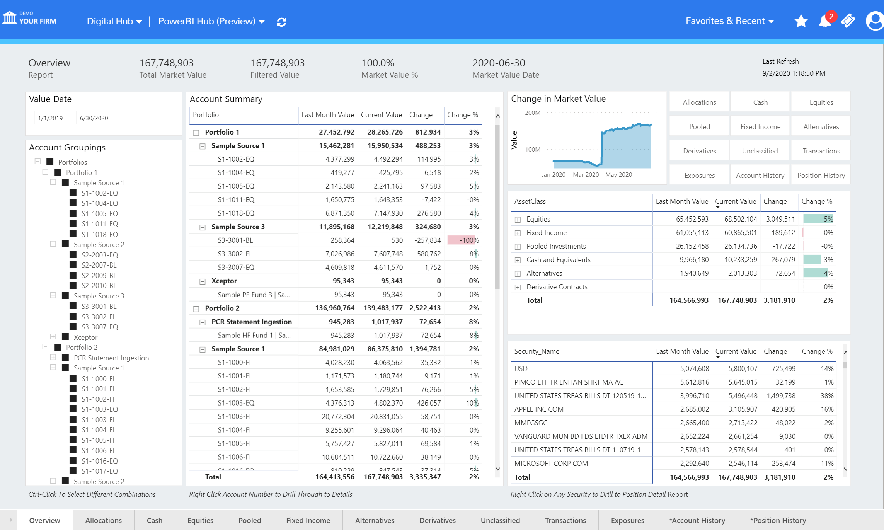
#6 REPORTING READY DATA
Leverage the Best Technologies for Reporting
Our open approach to integration and rich usable data enables our clients to use tools like Microsoft PowerBI and other reporting platforms to manage their complex custom reporting needs.

Slide 10
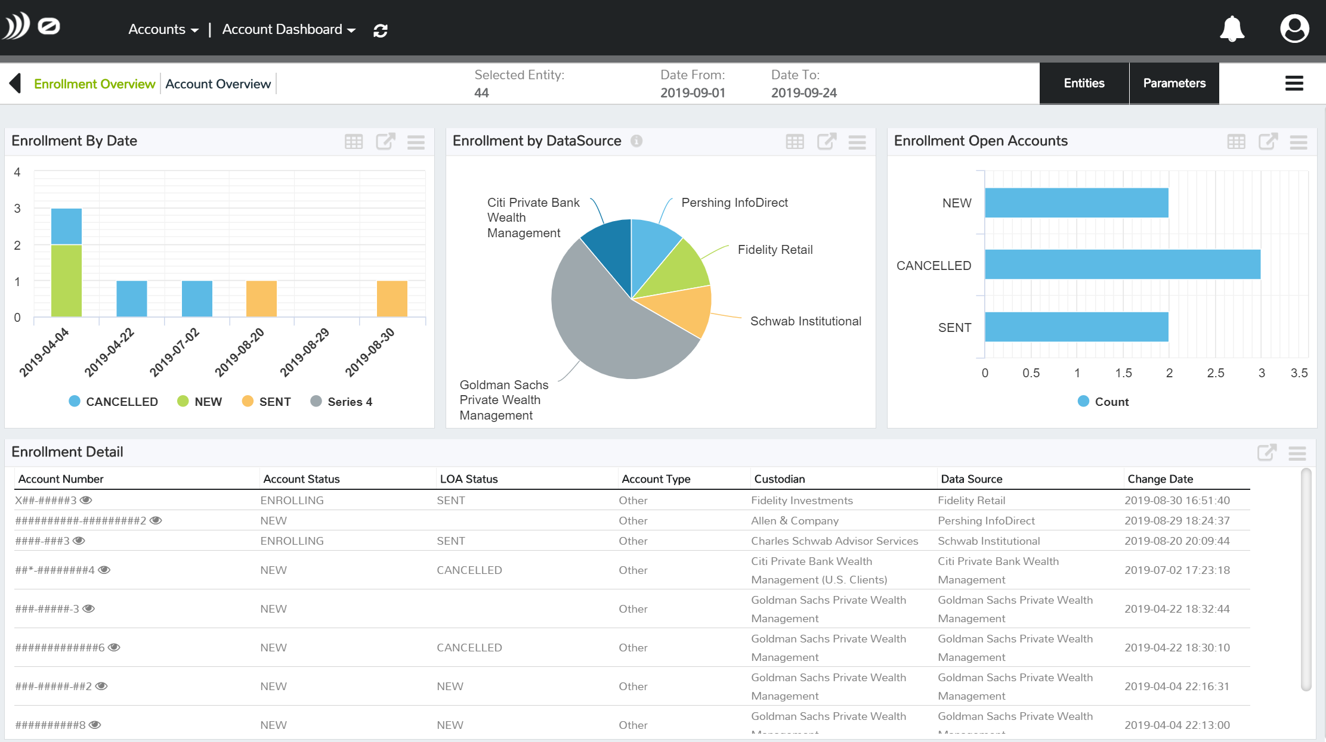
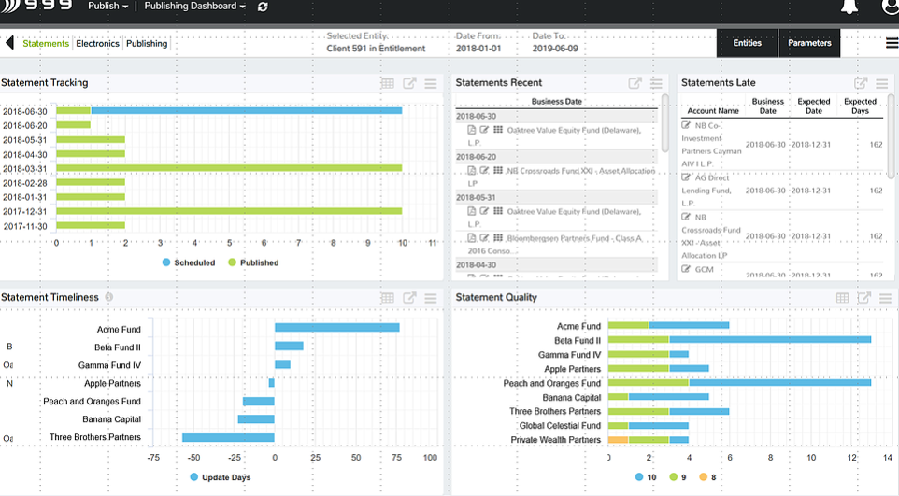
#7 MORE THAN A BLACK BOX
1
2
3
Transparent
Provides visibility on all processing including timeliness, quality, workflows and problem resolution.
Customizable
50+ Views Easily customized to match a firm’s organization and workflow needs.
Extensible
Allows surfacing data from other non-PCR data sources for easy analysis and correlation
ENROLLMENT TRACKING (Sample)
STATEMENT TRACKING (Sample)
Pending Enrollments | Signature Status | Manager Acceptance | Data Flow | Workflow
Expected Statements | Follow-up | Manager Quality and Timeliness | Link to Documents | Workflow

Slide 11
Thank YOU.
Learn more at www.pcrinsights.com | sales@pcrinsights.com

